Slide 1
AI, Analytics, and Innovation: My Cotiviti Internship Journey
11/03/2025
Pooja Kabadi

Slide 2
Agenda
1 | About myself
2 | My Internship goals
3 | Internship Progress Timeline
4 | Ask Data POC – AI Data Agent
5 | E&M LOS Recalibration
6 | Feedback and Learnings
7 | Q & A

Slide 3
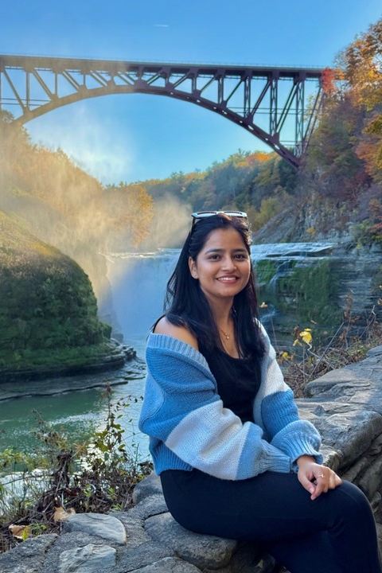




Professional Roadmap
Architect Urban Frame
Data Analytics Consultant LEAD
Business Intelligence Developer COTIVITI
Business Data Analyst University at Buffalo
Data & Insight Analyst Intern COTIVITI
Why Cotiviti:
Purpose-driven company transforming healthcare through data and analytics
Opportunity to work on impactful, enterprise-scale data products
Strong culture of innovation, collaboration, and continuous learning
Every project connects technical excellence with measurable business outcomes
What’s Best About Working in the OI Team:
Prior experience with OI in India, familiar culture of trust and ownership
Encourages end-to-end responsibility with continuous leadership guidance
Flat structure: collaborate directly with CMDs, CPMs, and leaders
Steep learning curve with exposure to both business and technical sides
Work with inspiring mentors like Jon, Roland, Pranay, Des & back in India with Namrata, Sanket, Nitin and Preeti
See your work’s real impact once analytics solutions go live
Pooja Kabadi

Slide 4
Internship Goals
Learning & Growth
Apply advanced analytics to real healthcare data
Build AI-powered solutions for business insights
Collaborate across clinical, product, and engineering teams
Learn to translate business logic into data-driven outcomes
Contribute to scalable, production-ready analytics frameworks
Build confidence in owning end-to-end projects
Enhance problem-solving and critical-thinking abilities
Translating business requirements into technical deliverables
Building AI-driven data products in Microsoft Fabric
Deep understanding of E&M LOS and payer analytics
Value of ownership and accountability in Agile projects
Importance of collaboration across hierarchy and functions
Seeing how analytics drives real healthcare outcomes
Experienced how innovation thrive, evolving through AI & Data
Skills kit

Slide 5
Internship Progress Timeline
Tasks | Week 1 Aug 11th | Week 2 Aug 18th | Week 3 Aug 25th | Week 4 Sept 1st | Week 5 Sept 8th | Week 6 Sept 15th | Week 7 Sept 22nd | Week 8 Sept 29th | Week 9 Oct 6th | Week 10 Oct 13th | Week 11 Oct 20th | Week 12 Sept 27th | Week 13 Nov 3rd
Orientation & Team Integration
Project Scope
Data Transformation/ Cleaning
Descriptive Analysis & EAD
Claims Data Preparation
Validation & Summarization
Training AI Data Agent & AI Instructions
Back-End Data Definition & Framework
Defining Metric Logic & Query Validation
Testing & Documentation
Other Tasks: Web scrapping/DP Benchmark
E&M LOS Recalibration
Ask Data POC – AI Data Agent
Other Tasks

Slide 6
Ask Data POC
AI Data Agent – PPM Benchmark Library

Slide 7




Ask POC: PPM Benchmark Data Copilot Executive Summary
With the integration of Microsoft Fabric and generative AI, Cotiviti’s PPM Benchmark Library empowers clinical and business users to instantly translate healthcare data questions into SQL-driven insights, eliminating analyst dependency for repetitive requests and enabling faster, data-backed decisions
PROBLEM
SOLUTION
Clinical directors and business leaders lack instant access to enterprise data during discussions or reviews.
They rely heavily on analysts to extract or validate data, causing delays, reduced agility, and missed opportunities for real-time, data-informed decision-making.
The PPM Benchmark Data Copilot leverages Microsoft Fabric and AI-driven natural language processing to instantly convert plain English questions into optimized SQL queries and real-time answers.
Users can access benchmark metrics (e.g., GPV%, NPV%, Adoption Rates) across multiple hierarchies, customer, payer, policy, and rule, in seconds and without writing SQL.
MARKET VALUE
MISSION
Transforms Cotiviti’s ecosystem into a unified self-service analytics platform empowering clinical, product, and operations teams with instant data access.
The solution is designed to scale across all Opportunity Intelligence (OI) data products and multi-source ecosystems, creating a single, intelligent layer for enterprise data insight and decision-making.
To democratize data access by allowing every clinical and business leader to ask questions naturally and receive governed, audit-ready insights instantly.
Our mission is to create an AI-powered decision companion that bridges the gap between natural language and enterprise analytics, enabling faster, smarter, and transparent healthcare integrity decisions.
Notes:
Mike

Slide 8

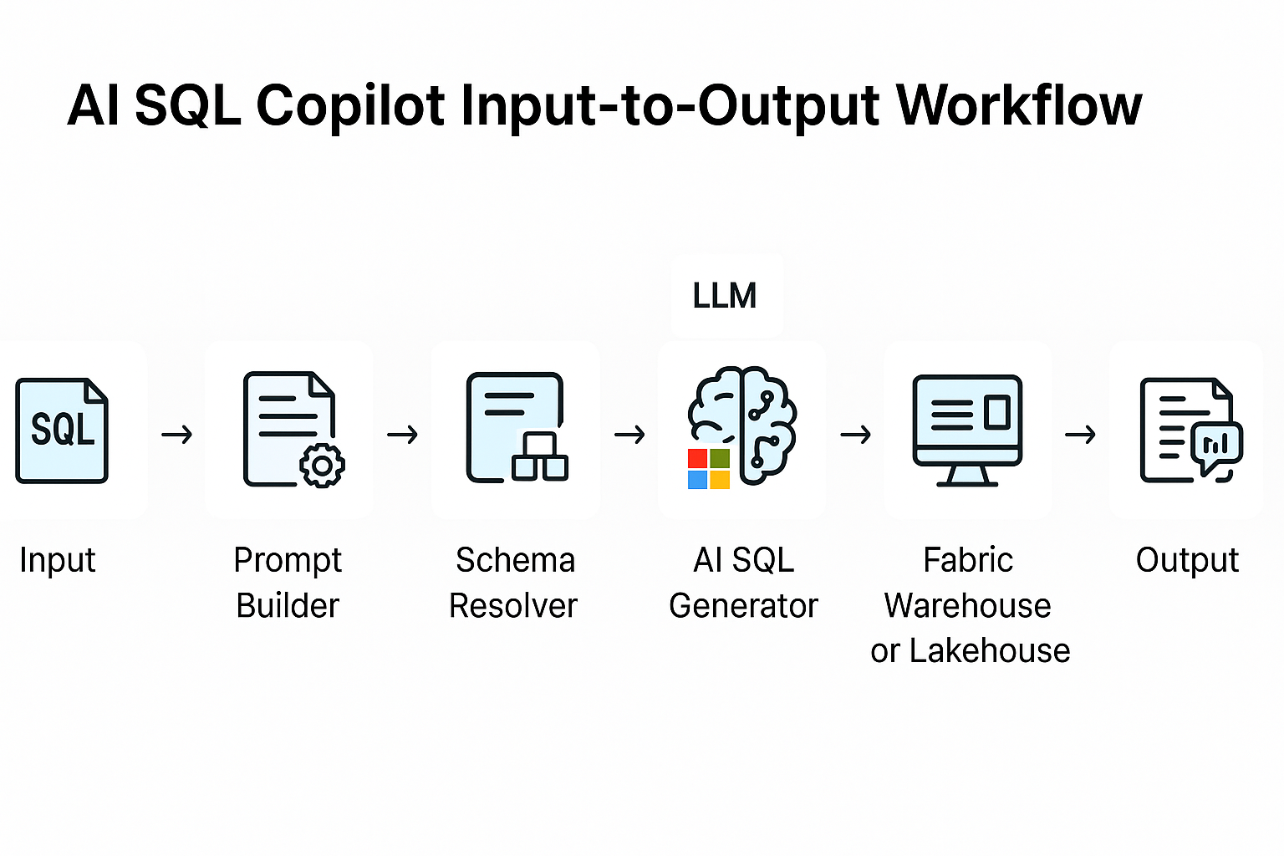

AI Data Agent Input-to-Output Workflow
The user gives a plain-language (or SQL-like) request, the Fabric AI Data Agent enriches it with our business rules, looks up the right metric + schema, asks the LLM to write SQL, validates it, runs it on your Fabric Lakehouse (PPM benchmark data), and then returns both data + insight text back to the user.
User Input
Prompt Builder
Schema Resolver
AI SQL Generator
Fabric Lakehouse
Output + Insights
Input / User Query The user enters a natural-language or SQL-style question that needs a benchmark metric or payer-level result.
Prompt Builder Setup
System and business rules are applied using predefined AI instructions to structure the request.
Metric & Schema Mapping
The agent fetches metric logic from the directory and identifies the correct tables using Fabric metadata.
AI SQL Generation The Microsoft Fabric AI model (LLM) converts the processed prompt into a validated SQL query.
Execution in Fabric Lakehouse
The generated SQL query runs securely on Fabric Warehouse/Lakehouse to retrieve data.
Insights & Output Delivery
Results are formatted into tables and summarized as key insights for the user.

Slide 9
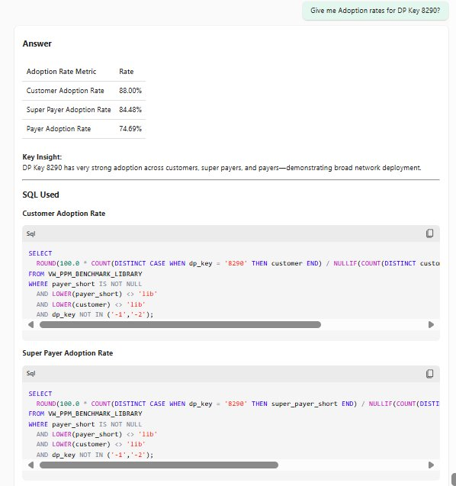
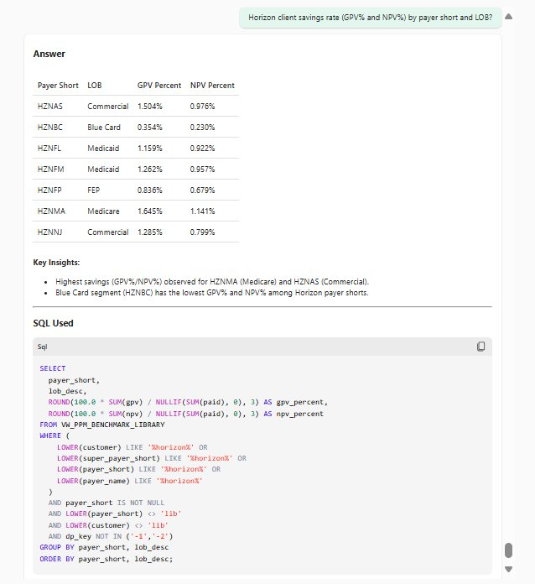
Ask POC: Examples
Example 1 – Give me Adoption Rates for DP 8290?
Example 2 – Horizon Clients Savings Rate by Payer short and LOB?

Slide 10

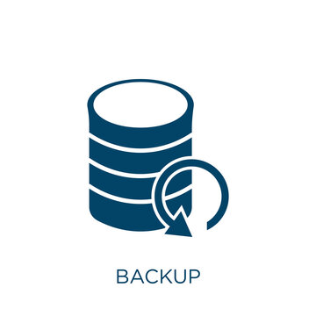



Next steps & Roadmap Ahead
Baseline Model (85% Accuracy)
Improve to 95%+ Accuracy
Integrate Multi-source Data
Explore Databricks & OCI Data Agents
Select & Scale the Best Platform
The existing Microsoft Fabric AI Data Agent achieves 85% SQL accuracy and serves as the foundation for enhancement
Optimize the AI instructions and prompts to expand the metric coverage and refine validation logic to reach 95%+ accuracy
Add multiple enterprise data sources into the Fabric Lakehouse to enable richer multi-layered Analytics
Experiment with alternate data agents like Databricks and OCI (Oracles Generative AI) to compare scalability and performance
Finalize the most efficient and secure platform to scale all OI-Data products and complex ad-hoc requests enterprise wide for quick insights

Slide 11
Evaluation and Management Level of Service Recalibration
Data Driven Approach for E&M LOS

Slide 12


Objective
Use our historical data to create a clear, fair, and data-driven baseline for Evaluation and Management policy (E&M) level of services (1-5) by diagnosis (ICD) and procedure group (CPT). This lets us standardize coding, flag outliers, and guide us to reclassify LOS where it’s appropriate.
Result:
Fewer adjustments & rework
Faster payment cycles
Measurable savings
Compliance & transparency
Notes:
Why this matters (Business impact)
Fewer adjustments: Transparent, evidence-based levels reduce rework and back-and-forth.
Faster payment cycles: Cleaner, consistent decisions mean fewer delays and quicker adjudication.
Measurable savings: Identify and correct high-level (4/5) usage that doesn’t fit the pattern, without sacrificing fairness.
Consistency & compliance: Versioned, auditable rules that evolve with ICD/CPT updates and changing practice.
Better provider experience: Clear rationale reduces abrasion and supports predictable outcomes.

Slide 13
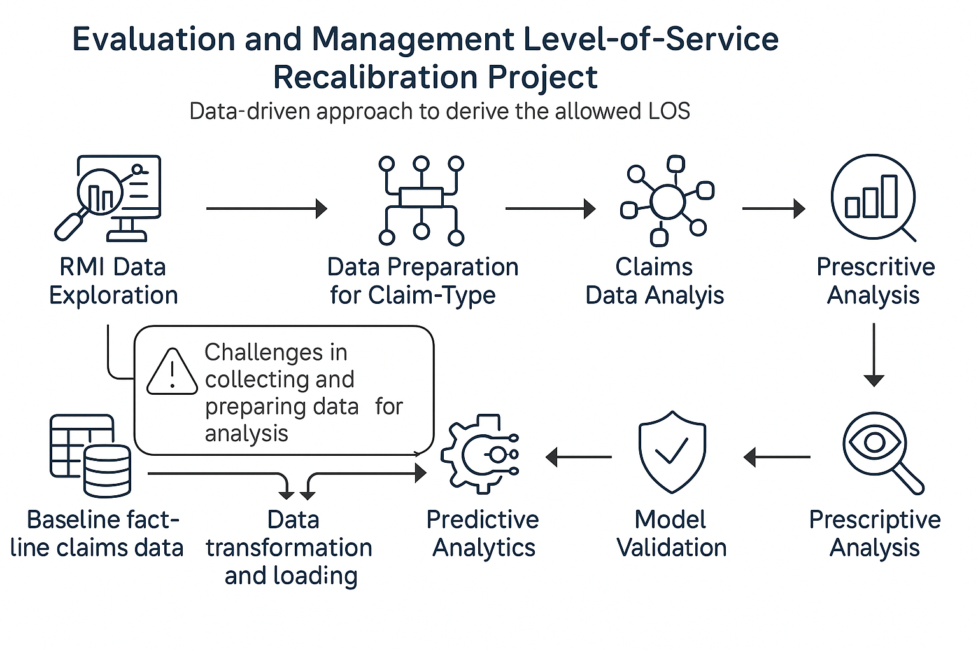






Evaluation & Management LOS Recalibration – Process Overview
Data-driven approach to derive the Allowed LOS
RMI Data Exploration
RMI Data transformation & treatment
RMI Data EDA (Allowed LOS) Descriptive Analysis
Claims Data Preparation
Claims Data EDA (Billed LOS) Descriptive Analysis
Predictive Analysis
Model Validation
& SME check
Prescriptive Analysis
Claims Data - Fact line
Joining treated RMI Data
Creating a table in Hive
Production release & Maintenance
Data & Model Validation
Faced Challenges in preparing Claims data for Analysis
Complex process to integrate the allowed and billed LOS in Claims data
Demanded the creating of custom base table for allowed LOS and then join the required data points

Slide 14




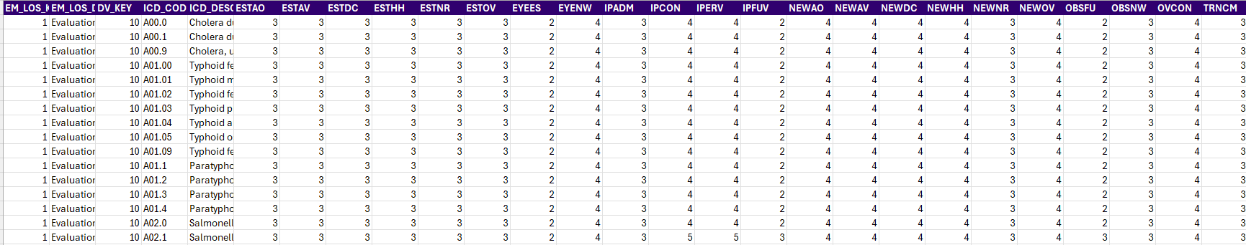
Data Overview
Existing E&M LOS Data from RMI
Data transformation: standardize raw inputs into an analysis-ready format
Explore current LOS data to understand LOS by Procedure and ICD
Analyze Claims data such as billed LOS, adjustments, etc. to standardize the LOS
Source: RMI
Date: 08/25
Size: 184k rows & 27 columns
LOS Range: 2-5

Slide 15
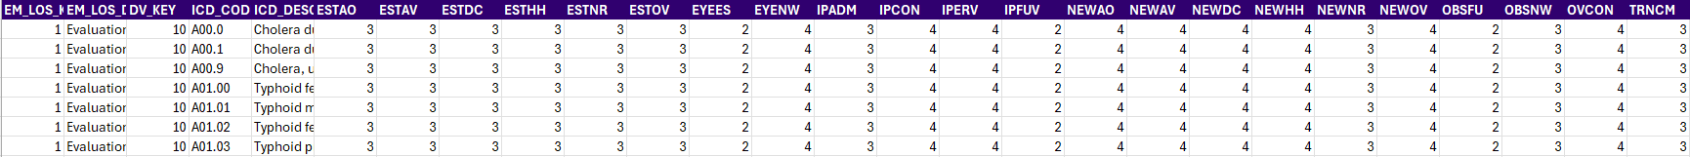
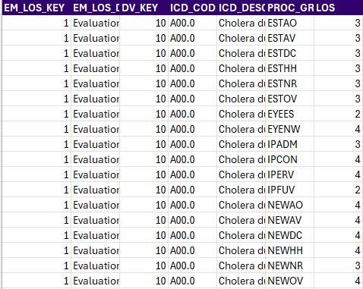
Data Transformation
Notes:
“We reshaped raw files into an analysis-ready format, wide to long- so each diagnosis × procedure shows up cleanly.”
“This gives us apples-to-apples comparisons and reliable KPIs across the portfolio.

Slide 16



Set Allowed Levels by Family: What Actually Occurs
Baseline LOS Mix: What’s Typical vs. Rare
LOS 2-3 80%
LOS 4-5 20%
LOS 4-5 0%
Outpatient (and partly Inpatient/New Patient) is associated with higher LOS, L4, L5 -> Claims analysis might reveal less adjustment
Transitional Care, Observation and Eye Exam are concentrated in L2. -> Claims analysis might reveal high adjustment
Established Care are majorly lower-level LOS allowed L3 -> -> Claims analysis might reveal moderate adjustment
Lower allowed
LOS
Higher allowed
LOS
Obsolete
Zone

Slide 17
Examples for Outpatient Consult Procedural family
OP Consultation
DV_KEY | EM_LOS_DESC | ICD_ROOT | ICD_DESCRIPTION | Procedure Group | Procedure family | n | LOS-3 | LOS-4 | LOS-5
10 | Evaluation and Management Level of Service Links for ALL | H33 | Unspecified retinal detachment with retinal break, right eye | OVCON | Outpatient Consultation | 65 | 0 | 36 | 29
10 | Evaluation and Management Level of Service Links for ALL | S22 | Wedge compression fracture of unspecified thoracic vertebra, initial encounter for closed fracture | OVCON | Outpatient Consultation | 354 | 205 | 149 | 0
10 | Evaluation and Management Level of Service Links for ALL | S96 | Unspecified injury of muscle and tendon of long flexor muscle of toe at ankle and foot level, right foot, initial encounter | OVCON | Outpatient Consultation | 180 | 105 | 75 | 0

Slide 18
High-LOS Hotspots - Share of LOS 4/5 by Diagnosis × Procedure Group
ICD_Root | ICD Description | ESTAO | ESTAV | ESTDC | ESTHH | ESTNR | ESTOV | EYEES | EYENW | IPADM | IPCON | IPERV | IPFUV | NEWAO | NEWAV | NEWDC | NEWHH | NEWNR | NEWOV | OBSFU | OBSNW | OVCON | TRNCM | Grand Total
A19 | Acute miliary tuberculosis of a single specified site | 5 | 5 | 5 | 5 | 5 | 5 | 4 | 4 | 3 | 5 | 5 | 3 | 5 | 5 | 5 | 5 | 3 | 5 | 3 | 3 | 5 | 3 | 4.364
A81 | Creutzfeldt-Jakob disease, unspecified | 5 | 5 | 5 | 5 | 5 | 5 | 4 | 4 | 3 | 5 | 5 | 3 | 5 | 5 | 5 | 5 | 3 | 5 | 3 | 3 | 5 | 3 | 4.364
P51 | Massive umbilical hemorrhage of newborn | 4 | 4 | 4 | 4 | 4 | 4 | 4 | 4 | 3 | 5 | 5 | 3 | 5 | 5 | 5 | 5 | 3 | 5 | 3 | 3 | 5 | 3 | 4.091
P39 | Neonatal infective mastitis | 4 | 4 | 4 | 4 | 4 | 4 | 4 | 4 | 3 | 5 | 5 | 3 | 5 | 5 | 5 | 5 | 3 | 5 | 3 | 3 | 5 | 3 | 4.091
P90 | Convulsions of newborn | 4 | 4 | 4 | 4 | 4 | 4 | 4 | 4 | 3 | 5 | 5 | 3 | 5 | 5 | 5 | 5 | 3 | 5 | 3 | 3 | 5 | 3 | 4.091
P03 | Newborn affected by breech delivery and extraction | 4 | 4 | 4 | 4 | 4 | 4 | 4 | 4 | 3 | 5 | 5 | 3 | 5 | 5 | 5 | 5 | 3 | 5 | 3 | 3 | 5 | 3 | 4.091
P50 | Newborn affected by intrauterine (fetal) blood loss from vasa previa | 4 | 4 | 4 | 4 | 4 | 4 | 4 | 4 | 3 | 5 | 5 | 3 | 5 | 5 | 5 | 5 | 3 | 5 | 3 | 3 | 5 | 3 | 4.091
P05 | Newborn light for gestational age, unspecified weight | 4 | 4 | 4 | 4 | 4 | 4 | 4 | 4 | 3 | 5 | 5 | 3 | 5 | 5 | 5 | 5 | 3 | 5 | 3 | 3 | 5 | 3 | 4.091
P52 | Intraventricular (nontraumatic) hemorrhage, grade 1, of newborn | 4 | 4 | 4 | 4 | 4 | 4 | 4 | 4 | 3 | 5 | 5 | 3 | 5 | 5 | 5 | 5 | 3 | 5 | 3 | 3 | 5 | 3 | 4.091
P07 | Extremely low birth weight newborn, unspecified weight | 4 | 4 | 4 | 4 | 4 | 4 | 4 | 4 | 3 | 5 | 5 | 3 | 5 | 5 | 5 | 5 | 3 | 5 | 3 | 3 | 5 | 3 | 4.091
Notes:
High-Dollar Hotspots (Share of 4/5 by Diagnosis × Procedure)
“Heatmap highlights where high levels cluster - our highest-impact targets.”
“Start with the dark clusters: put in guardrails/document checks; then monitor for movement toward mid-levels.”

Slide 19
LOS Consistency Map: Green / Yellow / Red
Stoplight legend & how we’ll use it:
Green (consistent) - A single LOS across all ICD versions within an ICD × CPT group (mode confidence = 100%). Example: For CPT ESTOV, all versions of ICD A00.x resolve to LOS 3. Coverage: ~88% of RMI ICD × CPT pairs.
Yellow (mixed but directional) - Mode confidence ≥60% and <100% (some variation). Example: ICD Z95 with CPT TRNCM appears as LOS 2 and LOS 3.
Red (unstable) - Mode confidence <60% (no clear dominant level).
What we’ll do next:
Green (majority): Validate the baseline against actual claims (billed LOS) and quantify $ adjustments due to LOS edits.
Yellow & Red (smaller share): Do the same claims validation plus SME review to understand patterns and set a defensible, data-driven approach for future diagnoses and procedures.

Slide 20

Next Steps:
Why we started with descriptive analysis (Phase 1) and how it helps:
Descriptive analytics tells us what’s actually happening in our historical expert assignments, where the patterns are strong vs weak, and where we need guardrails.
How this connects to the next phases:
Phase 2 – Claims validation & $ impact: We will link these baselines to real claims, measure adjustments rates and dollars, and confirm which settings produce savings without risk.
Phase 3 – Predictive baselines: Use these clear patterns of Statistical Analysis + claims evidence to build predictive logic that’s defensible and auditable.
Phase 4 – Automate & monitor: Turn the agreed baselines into rules/thresholds, put them behind explainable models, and add drift monitoring to keep performance steady.

Slide 21
Lessons Learned during Internship
Feedback for Team & Company
Web Scraping Exposure: Gained hands-on experience in Python-based web scraping for couple U.S. states for Legal team, my first real-world exposure to web crawling
E&M Project Complexity: Understood the business impact of LOS recalibration and how accurate data modeling drives payer efficiency and clinical transparency.
Enterprise AI Application: Learned the difference between academic and real-world AI by creating an AI Data Agent on Microsoft Fabric using healthcare data.
Ownership & Accountability: Taking end-to-end responsibility strengthened my decision-making, problem-solving, and professional confidence.
Creativity & Business Thinking: Learned to think beyond code, connecting analytics with business outcomes through collaboration with leadership teams and CMDs.
Exceptional Mentorship: Grateful for the guidance from amazing leaders, every discussion added technical depth and strategic clarity.
Collaborative Culture: The open, non-hierarchical environment encouraged idea-sharing, teamwork, and transparent communication.
Empowerment & Trust: Being entrusted with project ownership and independence helped me grow faster, the freedom to experiment while receiving constant feedback truly accelerated my learning curve.
Data Availability Feedback: Accessing data across multiple schemas was challenging; improved documentation and discoverability would enhance efficiency.
Continuous Improvement: Cotiviti’s openness to feedback and innovation fosters a strong learning culture for every team member.

Slide 22


Slide 24
Procedural group Abbreviations:
ESTAO → Established patient Annual (Other) Preventive exam (CPT 99391–99397; non-Medicare “physical”)
ESTAV → Established patient Annual Wellness Visit (Medicare AWV, G0439)
ESTDC → Established patient Domiciliary/Rest Home services (e.g., 99334–99337)
ESTHH → Established patient Home services (e.g., 99347–99350)
ESTNR → Established patient Nursing Facility services (subsequent care, e.g., 99307–99310)
ESTOV → Established patient Office/Outpatient visit (99212–99215)
EYEES → Eye exam, Established patient (92012, 92014)
EYENW → Eye exam, New patient (92002, 92004)
IPADM → Inpatient Admission / Initial hospital care (99221–99223)
IPCON → Inpatient consultation (99251–99255; payer-specific usage)
IPERV → Emergency Department visit (ED/ER services, 99281–99285) [label sometimes used even if not strictly “IP”]
IPFUV → Inpatient follow-up / Subsequent hospital care (99231–99233)
NEWAO → New patient Annual (Other) Preventive exam (99381–99387)
NEWAV → Initial Annual Wellness Visit (Medicare AWV, G0438)
NEWDC → New patient Domiciliary/Rest Home services (99324–99328)
NEWHH → New patient Home services (99341–99345)
NEWNR → New patient Nursing Facility services (initial, 99304–99306)
NEWOV → New patient Office/Outpatient visit (99202–99205)
OBSFU → Observation care, subsequent/follow-up (e.g., 99224–99226)
OBSNW → Observation care, initial/new (e.g., 99218–99220; note 2023 merges with inpatient E/M)
OVCON → Office/Outpatient consultation (99241–99245; payer-specific)
TRNCM → Transitional Care Management (99495–99496)

Slide 25
Feasible LOS by procedure Group

Slide 26
Example: Downcode Targets - High 4/5 Usage where typical Level ≤3
These are our best near-term savings: frequent 4/5 billing where the typical level is ≤3.
We can start with the longest bars: they combine high dollar potential with enough volume to act confidently.
Action: apply recode rules or documentation checks to these combos first; use guardrails where patterns are mixed.
Notes:
“Bars show combos where 4/5 is billed often, but the typical level is 2 or 3 - our best near-term savings.”
“Use the longest bars first: big potential and enough volume to act confidently.”
“Note: a bar like 26.66% is the review pool, not a guaranteed recode rate, actual impact depends on documentation and our HAL safety check.

Slide 27
Baseline LOS Mix: What’s Typical vs. Rare
LOS 2-3 80%
LOS 4-5 20%
LOS 1 0%
Lower allowed
LOS
Higher allowed LOS
Obsolete
Zone
Unused

Slide 28
Set Allowed Levels by Family: What Actually Occurs
0.03%
Outpatient (and partly Inpatient/New Patient) is associated with higher LOS, L4, L5 -> Claims analysis might reveal less adjustment
Transitional Care, Observation and Eye Exam are concentrated in L2. -> Claims analysis might reveal high adjustment
Established Care are majorly lower-level LOS allowed L3 -> -> Claims analysis might reveal moderate adjustment
Notes:
“This shows which levels actually occur in each family.”
“Observation and Established are concentrated → tight feasible sets; turn off unused levels.”
“Outpatient / some Inpatient/New Patient show meaningful 4/5 → keep a broader set but add documentation guardrails.”

Slide 29
E&M Claims Data Analysis
Procedural Family | Level of Service | Adjustments($)
Established | 4, 5 | $12,339,643
Eye Exam | 4 | $551,146
Inpatient | 3, 4, 5 | $6,999,554
New Patient | 3, 4, 5 | $1,465,191
Outpatient Consult | 4, 5 | $6,389

Slide 30
Pareto of Volume - Focus on Top procedure that drive most activity
NEWOV, IPCON, IPADM, ESTOV, IPFUV (leftmost bars) are the top volume drivers, standardizing these first gives the fastest impact.

Slide 31
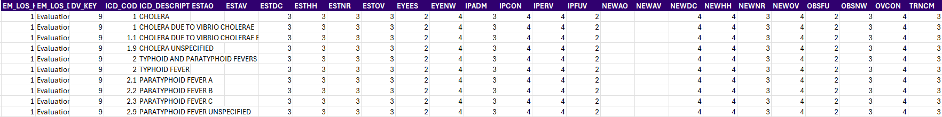
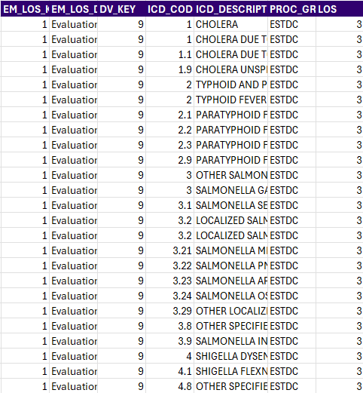
Data Transformation (Wide → Long)
.
.
.
.
.
.
.
.
.
.
.
.
.
.
.
.
.
.
.
.
.
.
.
.
.
.
.
.
.
.
.
.
.
.
.
.
.
.
.
.
.
.
.
.
.
.
.
.
.
.
.
.
.
.
.
.
.
.
.
.
Wide data: 27 columns x 184K rows
Long data: 7 columns x 4.1M rows
Data transformation standardizes raw inputs into an analysis-ready format.
.
.
.
.
.
.
.
.
.
.
.
.
.
.
.
.
.
.
Notes:
“We reshaped raw files into an analysis-ready format, wide to long- so each diagnosis × procedure shows up cleanly.”
“This gives us apples-to-apples comparisons and reliable KPIs across the portfolio.

Slide 32
Data Preprocessing
Standardization & Cleaning Data:
Text cleanup: removed odd spaces (NBSP), trimmed, upper-cased codes/groups; de-duplicated exact row duplicates using python libraries.
ICD normalization: built a robust ICD “root” = text left of the decimal for initial analysis (e.g., 003.21, 3.02.3.2 → root 3; J45.9, J45.2 → root J45)
Consistent types: coerced LOS to numeric; preserved nulls for coverage analysis.
Trustworthy baseline: clean, consistent inputs → defensible E&M benchmarks.
Notes:
“We cleaned text, standardized codes, and built a simple ‘ICD family’ using the part before the decimal.”
“We converted levels to numbers and kept blanks so we can measure data quality.”
“Net: a defensible baseline, consistent inputs, consistent decisions.

Slide 33
Objective
Use our historical data to create a clear, fair, and data-driven baseline for Evaluation and Management policy (E&M) level of services (1-5) by diagnosis (ICD) and procedure group (CPT). This lets us standardize coding, flag outliers, and guide us to reclassify LOS where it’s appropriate.
Result:
Fewer adjustments & rework
Faster payment cycles
Measurable savings
Compliance & transparency
Next Steps:
We’ve completed the descriptive baseline from RMI (allowed LOS) at ICD-root × CPT.
Next: validate against claims (billed LOS + $ adjustments), quantify misalignment, and refine rules with SME sign-off.
Then: deploy a predictive model to recommend LOS for new/sparse ICD×CPT pairs, publish versioned policy rules, automate application, and monitor drift
Notes:
Why this matters (Business impact)
Fewer adjustments: Transparent, evidence-based levels reduce rework and back-and-forth.
Faster payment cycles: Cleaner, consistent decisions mean fewer delays and quicker adjudication.
Measurable savings: Identify and correct high-level (4/5) usage that doesn’t fit the pattern, without sacrificing fairness.
Consistency & compliance: Versioned, auditable rules that evolve with ICD/CPT updates and changing practice.
Better provider experience: Clear rationale reduces abrasion and supports predictable outcomes.

Slide 34
Objective
Use our historical data to create a clear, fair, and data-driven baseline for Evaluation and Management policy (E&M) level of services (1-5) by diagnosis (ICD) and procedure group (CPT). This lets us standardize coding, flag outliers, and guide us to reclassify LOS where it’s appropriate.
Result:
Fewer adjustments & rework
Faster payment cycles
Measurable savings
Compliance & transparency
Next Steps:
We’ve completed the descriptive baseline from RMI (allowed LOS) at ICD-root × CPT.
Next: validate against claims (billed LOS + $ adjustments), quantify misalignment, and refine rules with SME sign-off.
Then: deploy a predictive model to recommend LOS for new/sparse ICD×CPT pairs, publish versioned policy rules, automate application, and monitor drift
Notes:
Why this matters (Business impact)
Fewer adjustments: Transparent, evidence-based levels reduce rework and back-and-forth.
Faster payment cycles: Cleaner, consistent decisions mean fewer delays and quicker adjudication.
Measurable savings: Identify and correct high-level (4/5) usage that doesn’t fit the pattern, without sacrificing fairness.
Consistency & compliance: Versioned, auditable rules that evolve with ICD/CPT updates and changing practice.
Better provider experience: Clear rationale reduces abrasion and supports predictable outcomes.

Slide 35
Set Allowed Levels by Family: What Actually Occurs
Baseline LOS Mix: What’s Typical vs. Rare
LOS 2-3 80%
LOS 4-5 20%
LOS 4-5 0%
Outpatient (and partly Inpatient/New Patient) is associated with higher LOS, L4, L5 -> Claims analysis might reveal less adjustment
Transitional Care, Observation and Eye Exam are concentrated in L2. -> Claims analysis might reveal high adjustment
Established Care are majorly lower-level LOS allowed L3 -> -> Claims analysis might reveal moderate adjustment
Lower allowed
LOS
Higher allowed
LOS
Obsolete
Zone

Slide 36
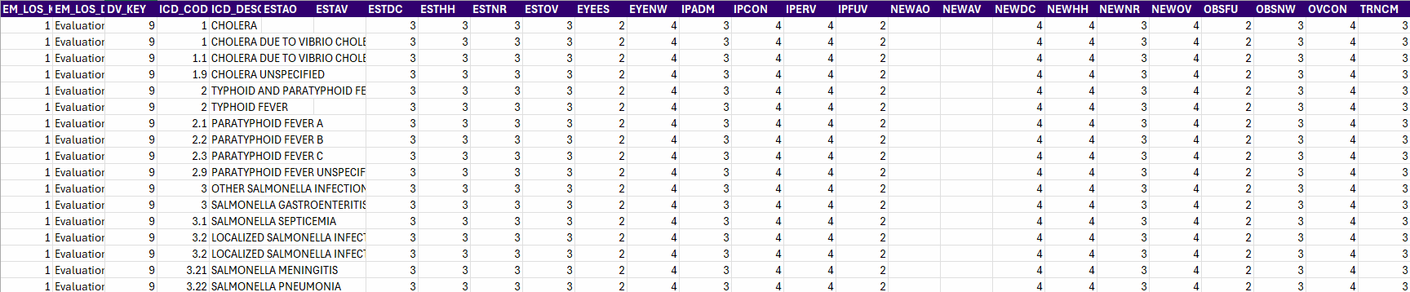
Data Overview & Workflow
Existing E&M LOS Data from RMI
Data transformation: standardize raw inputs into an analysis-ready format
Explore current LOS data to understand LOS by Procedure and ICD
Analyze Claims data such as billed LOS, adjustments, etc. to standardize the LOS
Source: RMI
Date: 08/25
Size: 184k rows & 27 columns
LOS Range: 2-5

